Slide 1
SEP Enquiries Form Testing
Sep 2019
Martin Kerr

Slide 2
Who we tested with
30 Online un-moderated test sessions, with Userzoom panel, for usability testing
3 Pre-Start/Early Startup businesses.

Slide 3
What we were trying to find out
We had the latest SEP Enquiry Form prototype to test. It was intended to allow us to test Enquiries form functionality.
We were interested in:
Did the new version of the form work well for companies who were NOT yet trading
Did it still work well for companies that ARE trading

Slide 4
SEP Events Summary
The

Slide 5
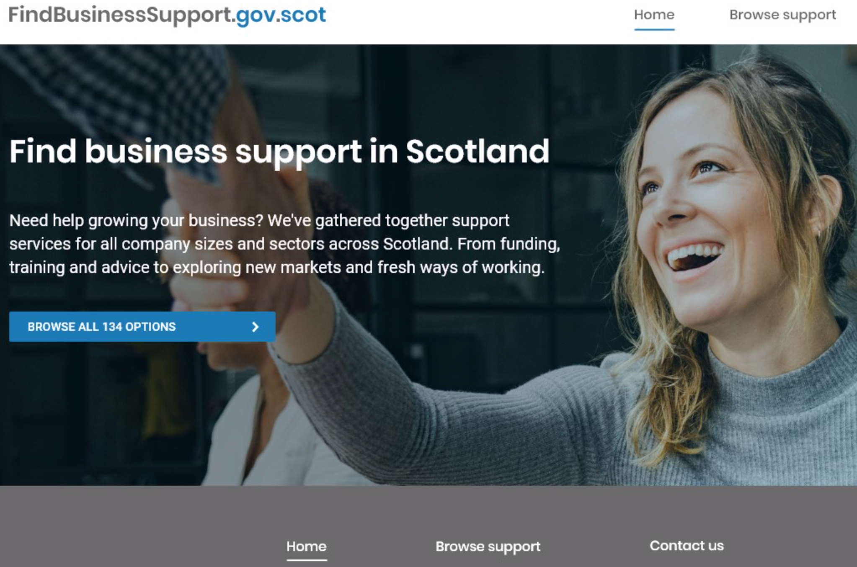
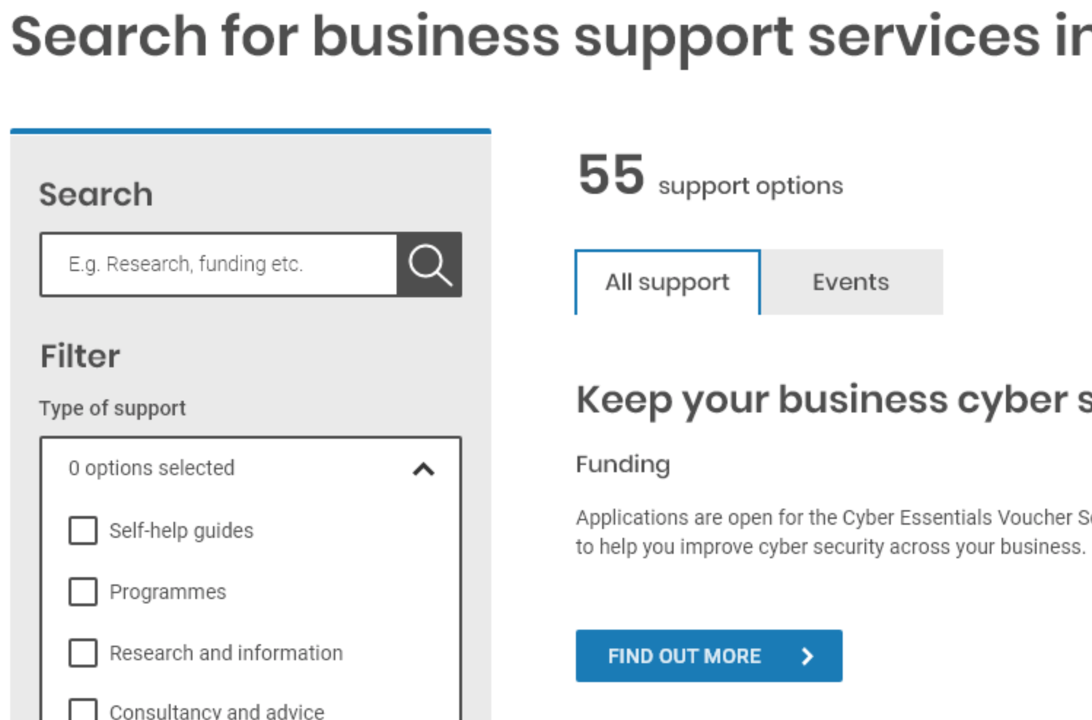
Number of support options
People noticed the number IF they used the Blue Button
A few people got quite confused by the number changing when they clicked through to the support listing
(55 support options + 79 Events = 134 number quoted on the home page)
Recommend dropping the number from the home page

Slide 6
Findings
We

